Slide 1

Prediction of mosquitos with West Nile Virus
03/25/2022 Hanpu Yao
MUSA capstone

Slide 2
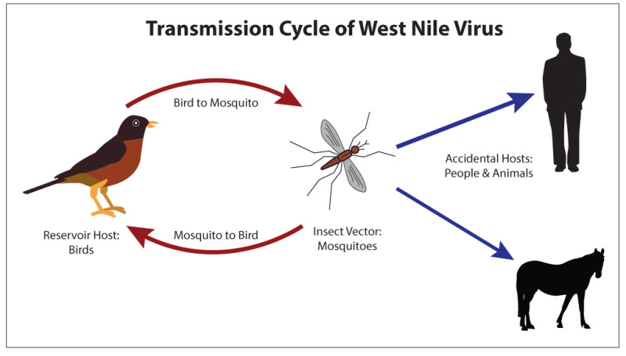
What is West Nile virus (WNV)
is the leading cause of mosquito-borne disease in U.S.
spread to people by the bite of an infected mosquito

Slide 3
Research question
Scale: City of Chicago
Goal: Predict the risk that WNV is present

Slide 4
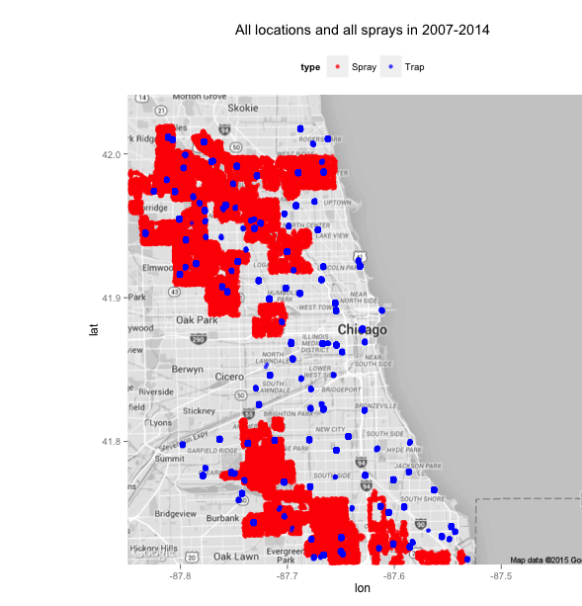
Datasets
Main data: mosquitos in traps
Time
Location
Mosquitoes:
numbers
Species
Whether or not WNV is present
Spray Data: spraying efforts to kill mosquitos
Time
Location

Slide 5
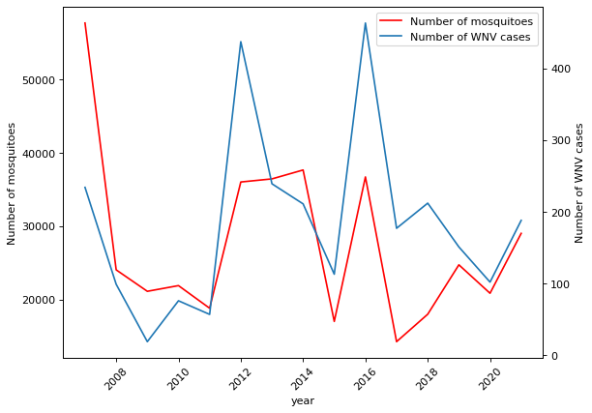
EDA - cases over years
Fluctuates
Very likely correlation between positivity and number of mosquitos

Slide 6
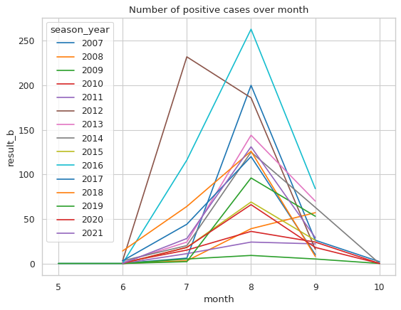
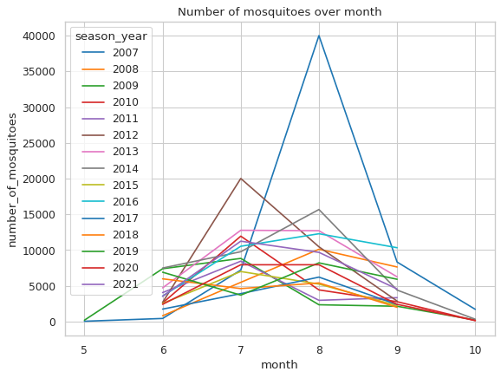
EDA - cases over months
Both peak in July and August

Slide 7
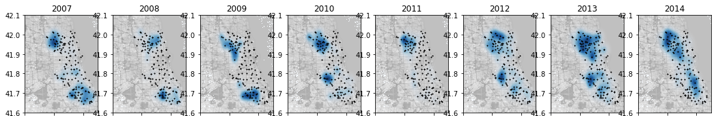
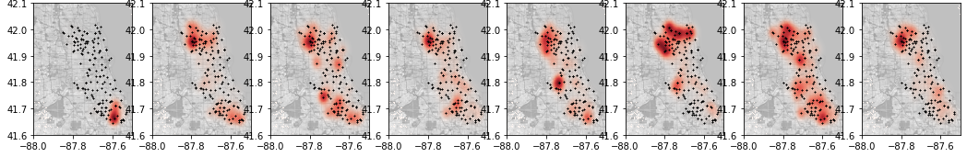
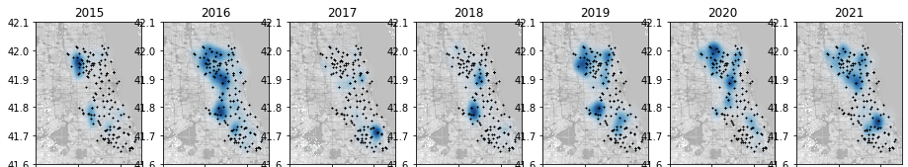
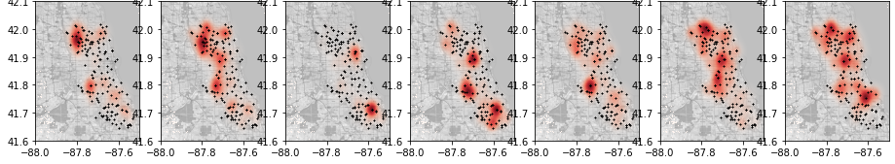
2007~2021
EDA - kernel density
Blue: positivity
Red: number of sample collected

Slide 8
2007~2021
Peaks in samples and cases are not often related in space
Blue: positivity
Red: number of sample collected

Slide 9
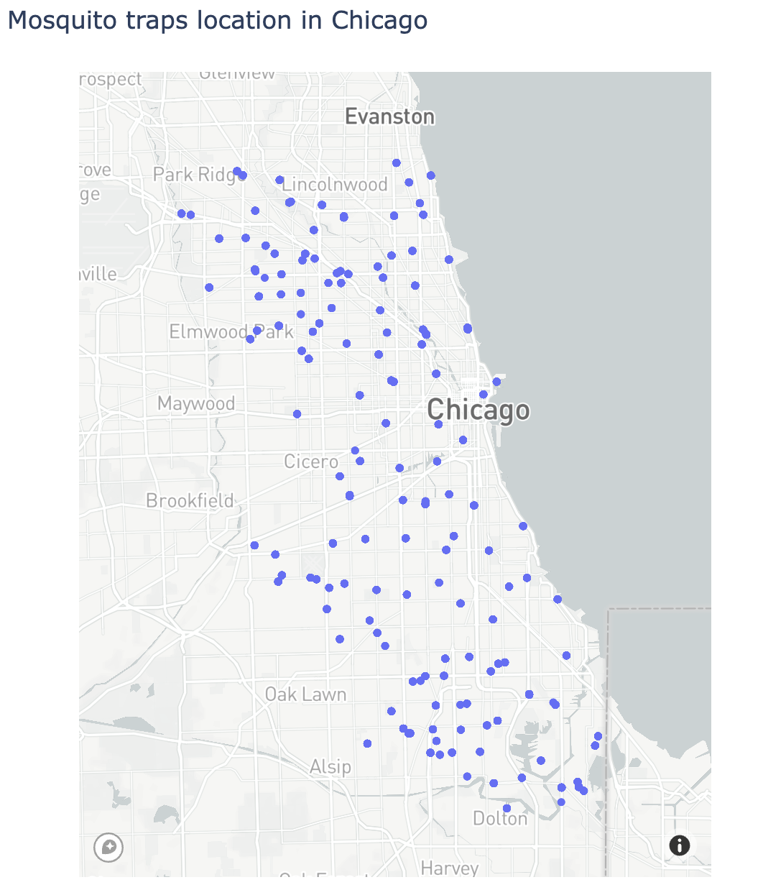
Feature engineering - Spatial lag with wind
Example:
Wind direction:
↗ Southwest
Wind speed:
Weight
Distance to the upwind point
Week k
Week k+1

Slide 10
Spatial lag with wind
Feature engineering:
spatialLag1 = [ (Positivity * # Mosquito) * Speed * cosθ / Distance] + [….]
The component vector of wind in the direction of traps
(Same as other upwind trap)
in a upwind trap
(from the last collecting time)
wind

Slide 11
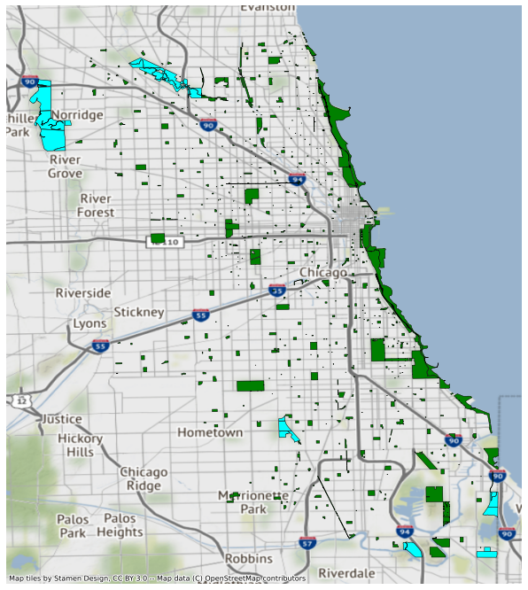
Spatial feature with geology component
Distance to 3 nearest：
Parks
Forests
311 bad sanitation place

Slide 12
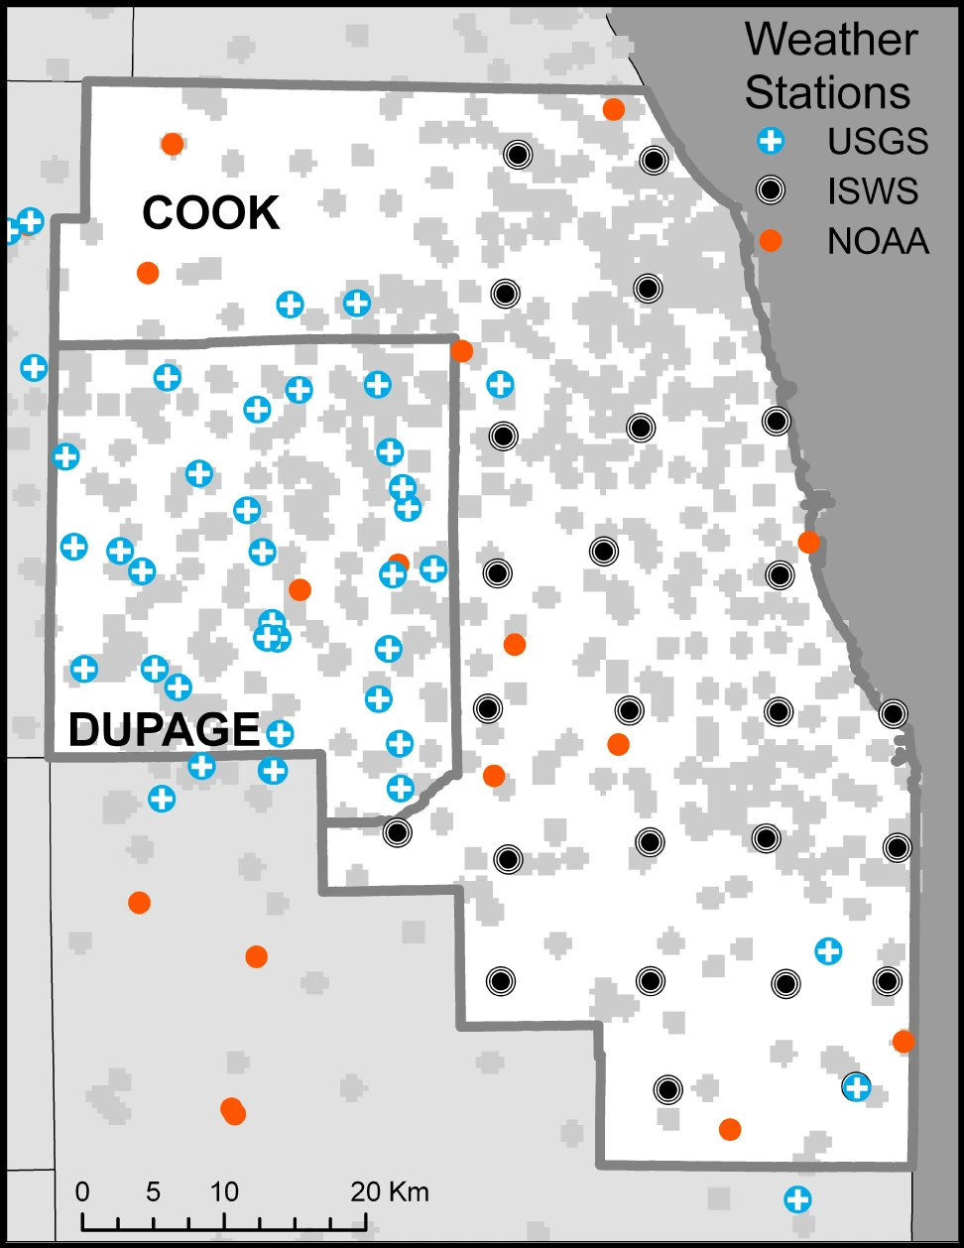
Temperature & precipitation
Data from ISWS and NOAA
Turning pdf to csv

Slide 13
Limitations
Spatial lag with wind assumes the city is flat
Real building environment is more complicated
Wind speed and direction in street scale maybe different with the whole scale
Solution: 1. Assumes the city is flat.
Or 2. Wrangle the city model data

